Slide 1
Mobile Health care for underserved community oneAPI - Data Analytics Library (oneDAL)
Team Name : BIT
Team Members: S.SRIRAM

Slide 2
Problem Statement
It is a pipe dream to be able to pay for adequate medical care in a nation where more than 90% of elderly people must work to make ends meet. Humans are living longer, and by 2050, there will be 53 million Oldest Old, or individuals who are 80 or older.
88% of people who are 80 years or older have serious diseases such high blood pressure, asthma, arthritis, heart issues, etc. Via its Mobile Healthcare Units aims to offer sustainable healthcare solutions to (undeserved)elderly people in need and their community.

Slide 3
Problem Statement
The healthcare condition among the poor is pathetic. These people lack in quality healthcare due to increased cost, lack of doctors and medicines. Healthcare camps are the only hope for the poor people who cannot afford to pay for expensive treatments or medicines.
Therefore patients should be treated with proper care, love, and respect in the camps. There should be no discrimination done at any stage of treatment.
Healthcare camps are the only hope for the unprivileged community where their problems are heard and resolved with respect and dignity.

Slide 4
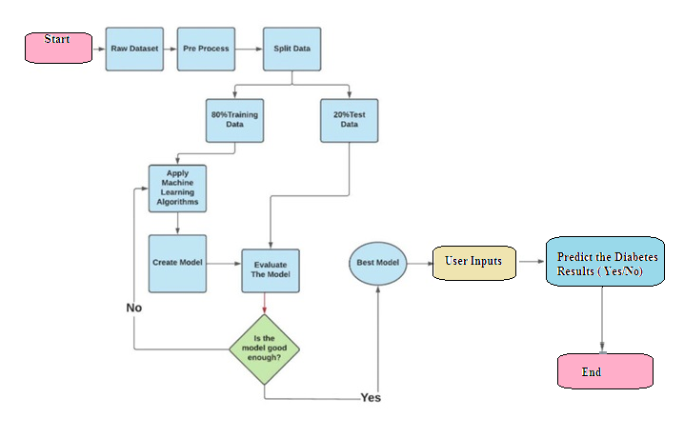
Flow Chart

Slide 5
Flow Chart -Explaination
Steps
Installing the Libraries
Importing the Dataset
Filling the Missing Values
Exploratory Data Analysis
Feature Engineering
Implementing Machine Learning Models
Predicting Unseen Data
Concluding the Report

Slide 6
Flow Chart -Explaination
Title given “ Diabetes Checkup” –Individual user inputs given such as (glucose level, Blood pressure) Adjusting the slider present in the application ,after that it will get process to Generate the Individual Result.

Slide 7
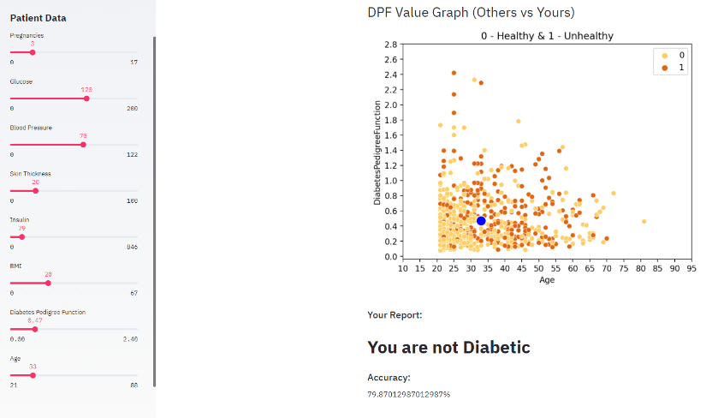
Output Samples

Slide 8
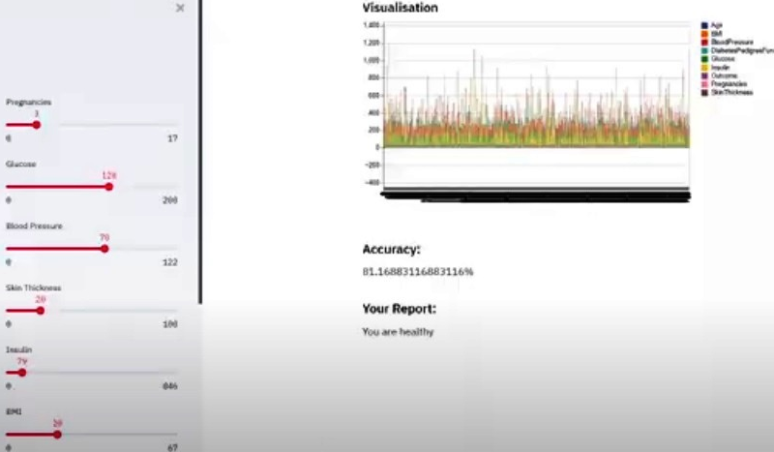
Output Samples

Slide 9
Architecture – Impact of oneAPI/SYCL (How oneAPI /SYCL helped you?) XGBoost : which stands for Extreme Gradient Boosting, is a scalable, distributed gradient-boosted decision tree (GBDT) machine learning library. It provides parallel tree boosting and is the leading machine learning library for regression, classification, and ranking problems.

Slide 10
Optimization : A better understanding of diabetic pathophysiology has contributed to the development of effective prevention or treatment of many of its complications. The systematic application of several therapeutic recommendations based on clinical evidence can significantly reduce the rate of diabetic complications and improve the quality of life of the diabetic patient.

Slide 11
Core components of oneAPI/SYCL used in the project Intel® oneAPI Data Analytics Library (oneDAL) XGBoost ( Intel® AI Analytics Toolkit) Benefits : Analyze large datasets with available compute resources. Make better predictions faster. Optimize data ingestion and algorithmic compute simultaneously. Support offline, streaming, and distributed usage models.

Slide 12
Demo Video/Live Demo Please elaborate oneAPI/SYCL usage https://youtu.be/TN7BIjl3Ja4

Slide 13
GitHub Link(Codes should be public and available after hackathon also)
https://github.com/SRISUDIV/Mobile-Health-care-for-underserved-community/blob/main/Healthcare_Project.ipynb
https://colab.research.google.com/drive/1g2U85DgvTDyKMbQpWXZbUHmJveBGA8hb?usp=sharing

Slide 14
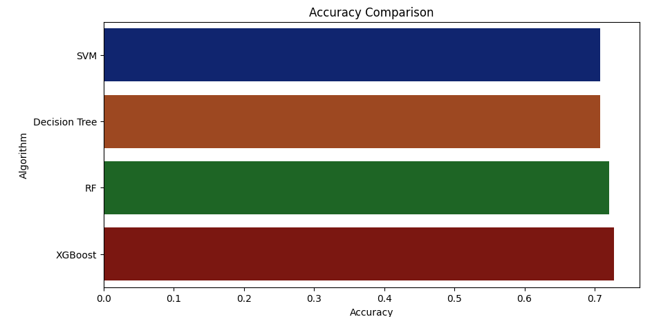
Results Summary(focus on unique aspects of oneAPI/SYCL that you have used)

Slide 15
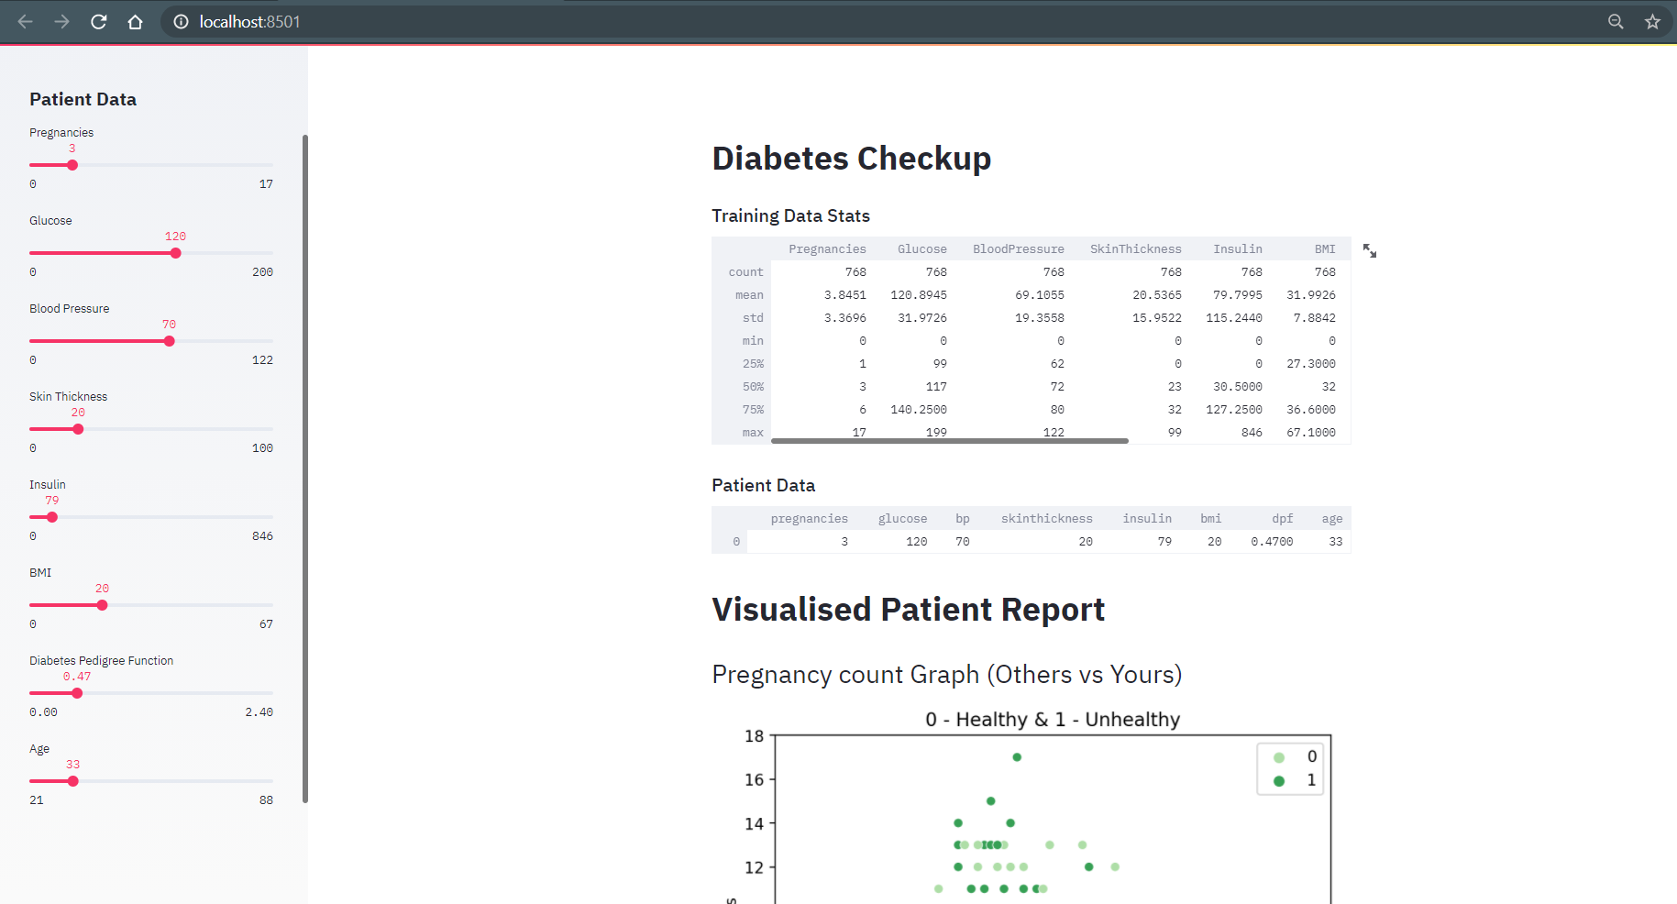
Results

Slide 16
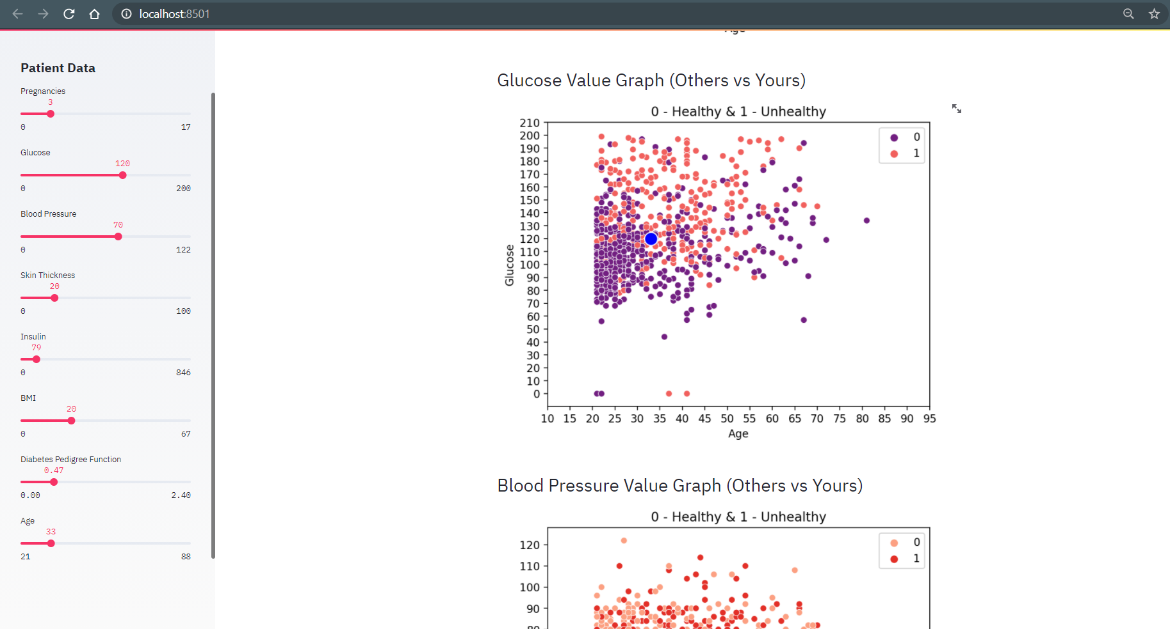
Results

Slide 17
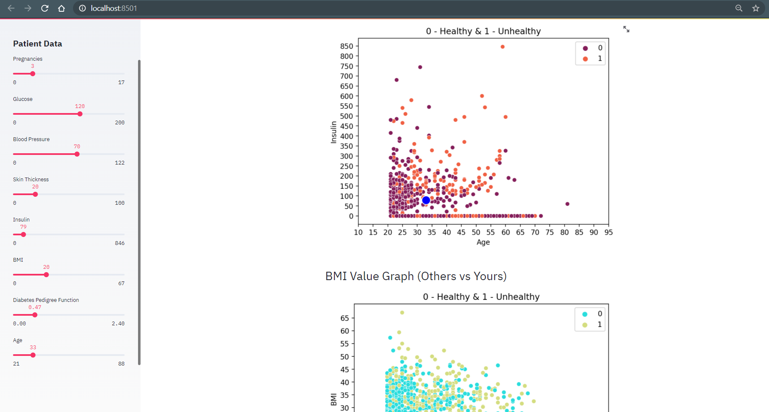
Results

Slide 18
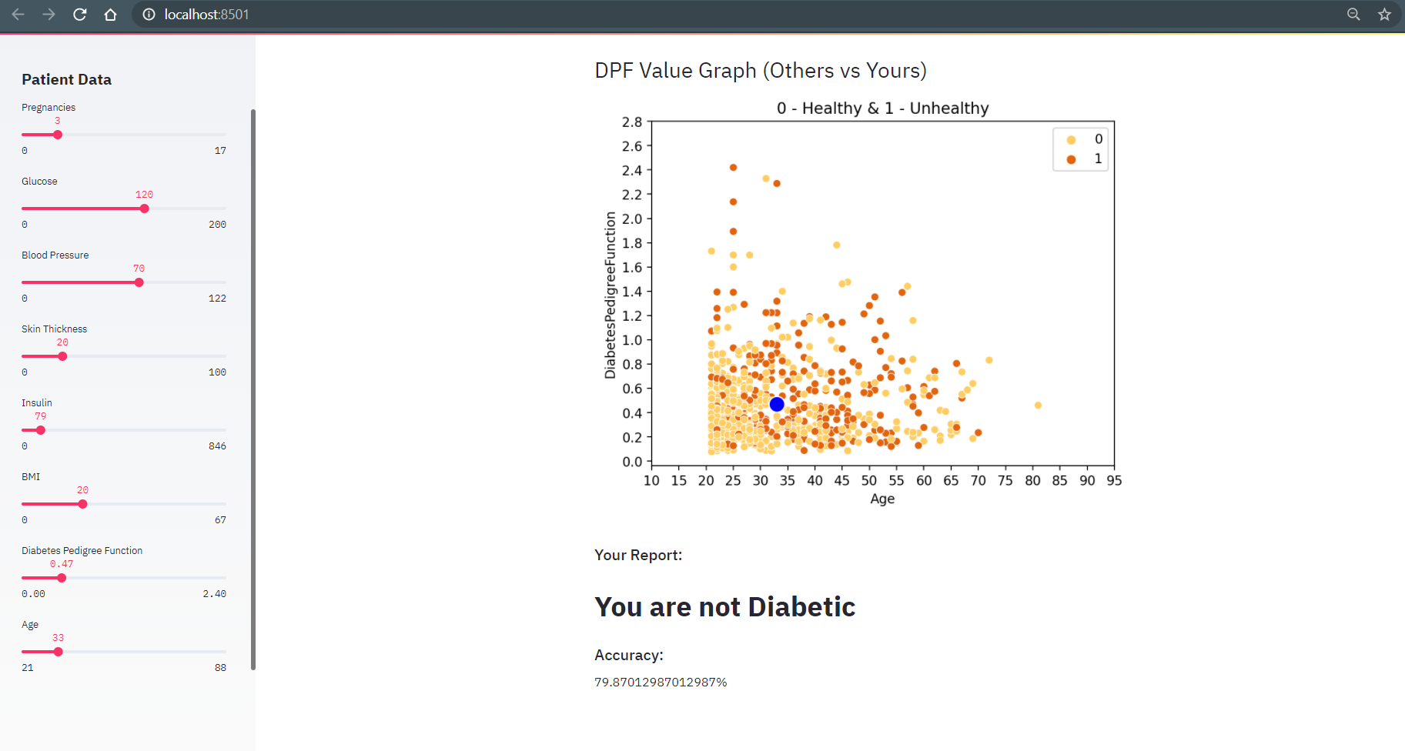
Results

Slide 19
Thank you

